Slide 1
Project : Twitter Hashtag Tracker
Moradabad Institute of Technology
Session : 2022-23
MINI PROJECT LAB (KCS 752)
KRATIKA
1900820100062

Slide 2
Twitter Hashtag Tracker
A Real Time Hashtag Tracker
It is a dashboard that converts raw data into useful, accurate and insightful metrics and predictive Twitter Hashtag analytics.

Slide 3
What can hashtag tracker “TRACK” ?
There are many “things” we can get twitter hashtag analytics out of. These are:
Hashtag Keyword
Twitter Account Phrase

Slide 4
ADVANTAGE OF THIS TRACKER
LETS HAVE A LOOK ON IT

Slide 5
#cadbury
This hashtag was trending under an ad campaign during the festive season in the year 2021….

Slide 6
85,26,124 tweets
Whoa! That’s a big number?

Slide 7
85,26,124 tweets
32,54,244 users
8,46,103 users
That’s a lot of tweets
And a lot of users
Were Verified users

Slide 8
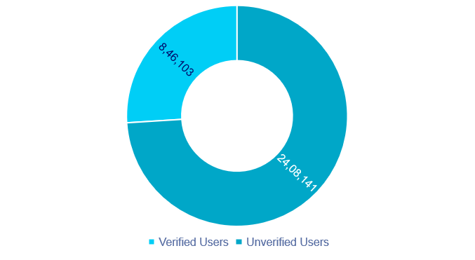
Users Distribution

Slide 9
FEATURES
Works In Real Time
Dashboard As User Interface
1
2
Multiple Trackers Facility
Download Graphs For Free
3
4

Slide 10
BACKEND TECHNOLOGY
PYTHON 3.9
Web scrapping using SNSCRAPE
Dataset formation using PANDAS
Web scrapping is used to scrape the real time data from the platform . With the help of pandas we create a dataset over which data visualization takes place.

Slide 11
FRONTEND TECHNOLOGY
PYTHON 3.9
Plotly to plot the graphs
DASH framework
Plotly is a library in python that allows users to create various types of dynamic plots or graphs such as Scatter plot, Bar charts etc.
Dash framework allows the users to deploy the python program onto a webpage.

Slide 12
LIMITATIONS
Only real time…
It shows the results of real time.
It is unable to show historic analytics.
Limited choice of Graphs
There are only limited number of predefined graphs available in the dashboard.
It is not possible for a user to create a new graph or plot.

Slide 13
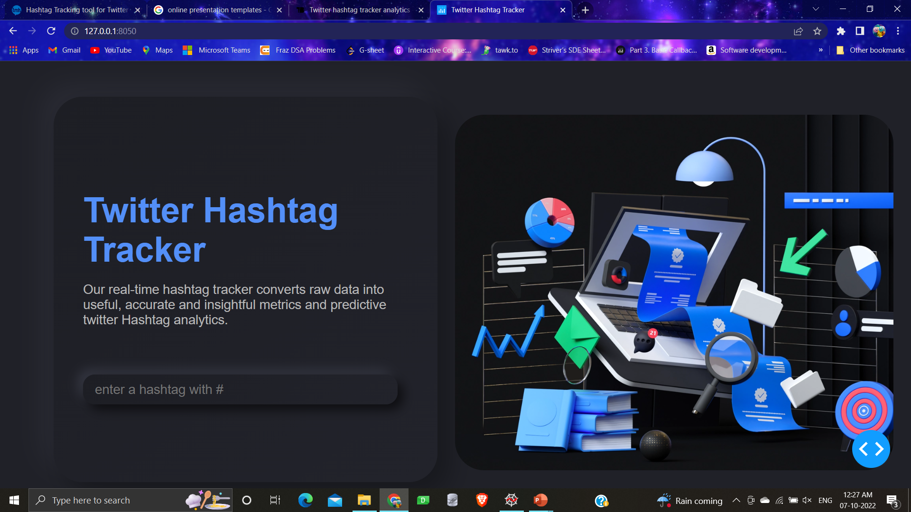
DESKTOP PROJECT
Let’s have a look on the project.

Slide 14
THANKS!

Slide 15
DIAGRAMS AND INFOGRAPHICS

Slide 16
Now you can use any emoji as an icon!
And of course it resizes without losing quality and you can change the color.
How? Follow Google instructions https://twitter.com/googledocs/status/730087240156643328
✋👆👉👍👤👦👧👨👩👪💃🏃💑❤😂😉😋😒😭👶😸🐟🍒🍔💣📌📖🔨🎃🎈🎨🏈🏰🌏🔌🔑 and many more...

Slide 17

Free templates for all your presentation needs
For PowerPoint and Google Slides
100% free for personal or commercial use
Ready to use, professional and customizable
Blow your audience away with attractive visuals

